Slide 1
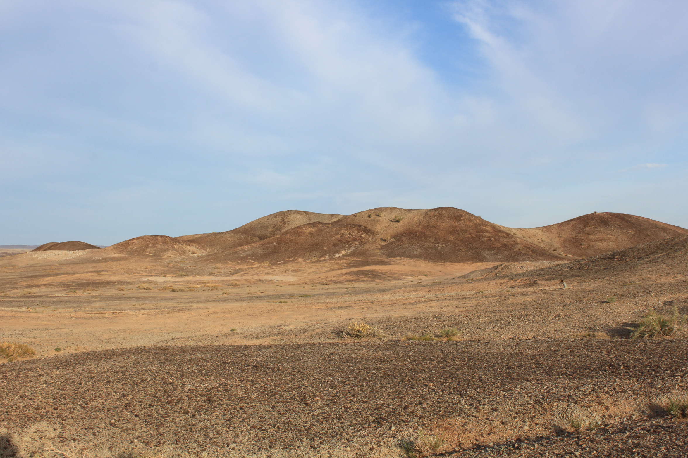
“ERDENES ALT RESOURCE” LLC
Exploration licenses
Photo: Company-owned, Khurentsav exploration area located in Shinejinst sum, Bayankhongor province Mongolia

Slide 2
About “Mukhar khar tolgoi” licensed exploration area
“ERDENES ALT RESOURCE” LLC
PROJECT OVERVIEW INFORMATION
Shareholder: |  | “ERDENES ALT RESOURCE” LLC
Location: |  | It is located in the area of ​​Shinjinst Sum, Bayankhongor Province, 13.4 km northwest of Dosh Mountain (1159.7m), on the northern edge of the L-47-6-G plane.
Coordinates: |  | Center point NL 43°49'40.4'', EL 98°55'45.1'' geographical coordinates.
Indication: |  | Au, Pb, Sb
The work is done in the field | Ground Magnetic Survey | 1788 km
 | Gradient Array | 89 km
 | IP (pole-dipole) Survey | 74 km
Phone, e-mail address: |  | +976-88110062 +976-98870088 info@erdenesalt.mn
RELATED DOCUMENTS
Feasibility Study
Plan
Environmental Assessment
Land Permit- 100%
Cooperation agreement with the local area - 100%
Has the funding been fully resolved
PROJECT INTRODUCTION:
It is located in the area of ​​Shinjinst Sum, Bayankhongor Province, 13.4 km northwest of Dosh Mountain (1159.7m), on the northern edge of the L-47-6-G plane. According to the results of boreholes MHTH001, MHTH002, MHTH003 drilled in Muhar Khar Tolgoi field (Au-Pb-Sb) as part of the "AMS-2017" project, all As and Sb samples have anomalous contents, and very rarely Cu, Pb, Li, and Au anomalous contents here and there.
It will be When the results of the analysis of these wells were compared with As, Sb, and Bi elements on the model of geochemical factors of porphyry deposits (Halley, Dilles, and Tosdal (2015)) by considering the correlation relationship using the Statview program, it appears that it is likely to be the top part of the porphyry deposit or the whole system. Therefore, since the manifestation is the top part of the porphyry deposit, it is believed that porphyry deposit is likely to be found by carrying out deep geophysical and drilling research work up to 800-1500m.
Geophysical work has been carried out. Also, comprehensive research work has been carried out at the expense of the state budget, mineral deposits have been identified, further detailed study of gas resources and deposits is necessary.

Slide 3
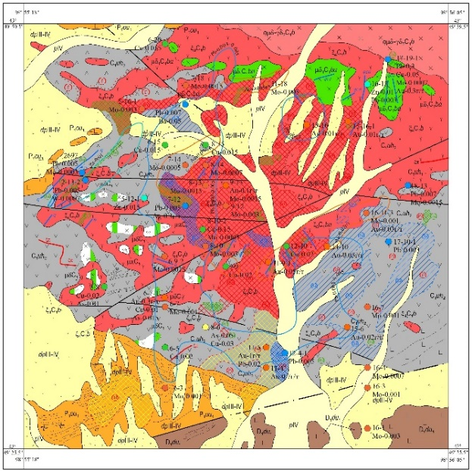
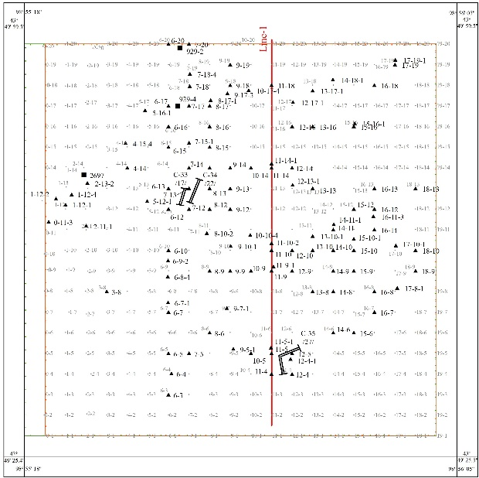
Studied-1. /2014-2018/. 1:50000 "Chandman mountain-50" project
“ERDENES ALT RESOURCE” LLC
Muhar Khar Tolgoin (Au-Pb-Sb) project by "Sudalt Mana" LLC 1:50000 scale geological group on map, general prospecting field survey, prospecting route-19 t/km, channel penetration 78.3 m3, spot sample 3 sh, primary geochemistry - 110 sq.m., 32 sq.m. with grooved samples, and geophysical work on an area of 11 t/km with 100 x 50 m grid using methods such as magnetic mapping, dipole-poldipole, and the results revealed promising gold-molybdenum mineralized points.

Slide 4
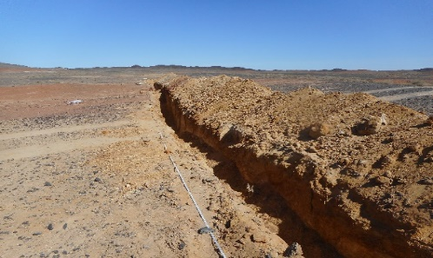
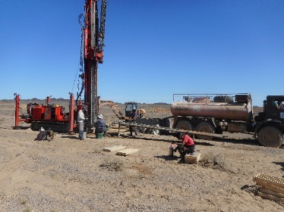
Studied-2. /year 2019/. "AMC-2017" project
“ERDENES ALT RESOURCE” LLC
In Muhar Khar Tolgoi field (Au-Pb-Sb), a total of 1,021.8 meters of drilling, 1,016 hours of concrete sampling, 4 hours of mineragraphy, and 6 hours of petrography were carried out in 3 wells with a depth of 198.5-432.8 m within the framework of the Geological Research Center SOE "AMS-2017" project. . This measurement has been completed by 4 lines with a length of 1200-1300 meters in a direction of 360 degrees from south to north, totaling 4.9 km.

Slide 5
About “Khalzan” licensed exploration area
“ERDENES ALT RESOURCE” LLC
PROJECT OVERVIEW INFORMATION
Shareholder: |  | “ERDENES ALT RESOURCE” LLC
Location: |  | It is located in Shinjinst sum area of ​​Bayankhongor province, 11.2 km southwest of Zuunmod, in front of L-47-7-A plane.
Coordinates: |  | Center point NL 43°53'10,5'', EL 99°07'27.5'' geographical coordinates.
Indication: |  | Cu, Mo, Au
The work is done in the field | Ground Magnetic Survey | 181 km
 | Gradient Array | 45 km
 | IP (pole-dipole) Survey | 18 km
Phone, e-mail address: |  | +976-88110062 +976-98870088 info@erdenesalt.mn
RELATED DOCUMENTS
Feasibility Study
Plan
Environmental Assessment
Land Permit- 100%
Cooperation agreement with the local area - 100%
Has the funding been fully resolved
PROJECT INTRODUCTION:
It is located in Shinjinst sum area of ​​Bayankhongor province, 11.2 km southwest of Zuunmod, in front of L-47-7-A plane.The results of the magnetic and electrical exploration work of the previous researchers and the AMC-2017 project at the level of detection are well correlated with the geological environment of the field, interesting polarization anomalies have been established in the relative electric shear lines at a depth of 100-350m, and the continuation of the polarization anomaly in the transformation zone in the intrusive outer host rocks indicates mineralization. shows that the depth can be continued.
The occurrence is similar to the Khul Mort group porphyry deposits located behind the Edren mountain range, near the Ulziit Khar mountain, 3 km northeast of the Elstein river, at the border of the L-47-137-G and K-47-5-B planes. watching. Further drilling and detailed geophysical exploration is required.
Geophysical work has been carried out. Also, comprehensive research work has been carried out at the expense of the state budget, mineral deposits have been identified, further detailed study of gas resources and deposits is necessary.

Slide 6
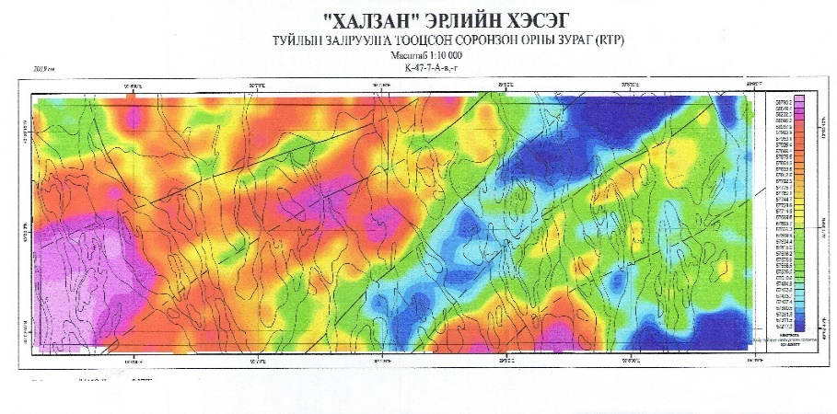
Studied-1. /2014-2018/. 1:50000 “KHailaast Uul-50" project
“ERDENES ALT RESOURCE” LLC
The occurrence of bald copper-gold (Cu,Au) was identified by Gurvantalst LLC's 1:50000 scale geological grouping map and general prospecting. The prospecting route was 42 t.km., channel penetration was 32.4 m3, and lithigeochemical sampling was carried out by secondary dispersion in a 100 x 50 m grid. 384 km, groove sampling 10 km, protolochek sample 6 km, point sample 22 km, primary geochemical sample 33 km, geophysical magnetic mapping 42 t.km, electrical exploration ГТДГ 24.2 tkm, electric exploration section Dipole-dipole 3.8 tkm.
Also 4 occurrences of copper, 4 mineralized points, secondary scatter ranges of copper, lead, tin, bismuth, and molybdenum geochemistry have been determined in the prospecting area of the "Khalzan" project, and copper occurrences have been evaluated.

Slide 7
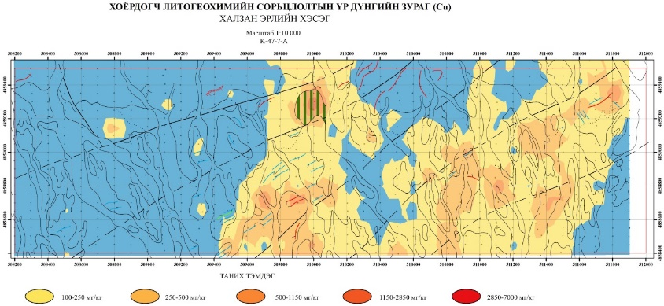
Studied-2. /year 2019/. "AMC-2017" project
“ERDENES ALT RESOURCE” LLC
Within the framework of the Geological Research Center (state-owned industrial estate) "AMS-2017" project, 882 tm of drilling, 879 samples of iron, 159 samples of primary geochemistry, search route 1 km, 3 points, 8 mineragraphs, 3 Sh petrograph, 16 sh Etolan, 4.4 t, km pole-dipole have been completed. The occurrence is similar to the Khul Mort Group porphyry deposits and occurrences near the Ulziit Black Mountains behind the Edren Mountains, and it is believed that further drilling and detailed geophysical exploration is necessary.

Slide 8
About “dovjoot” licensed exploration area
“ERDENES ALT RESOURCE” LLC
PROJECT OVERVIEW INFORMATION
Shareholder: |  | “ERDENES ALT RESOURCE” LLC
Location: |  | Bayankhongor Province Bayan-Undur Sum area, near the low hill on the west side of Dovjoot Har Mountain (1760m), in the northwest part of L-47-137-B plane, center point 44°05' 31.7 "98°02'29.2" geographical coordinates.
Coordinates: |  | Center point NL 44°05' 31.7“ EL 98°02'29.2" geographical coordinates.
Indication: |  | Cu, Mo, Au
The work is done in the field | Ground Magnetic Survey | 569 km
 | Gradient Array | 57 km
 | IP (pole-dipole) Survey | 57 km
Phone, e-mail address: |  | +976-88110062 +976-98870088 info@erdenesalt.mn
RELATED DOCUMENTS
Feasibility Study
Plan
Environmental Assessment
Land Permit- 100%
Cooperation agreement with the local area - 100%
Has the funding been fully resolved
PROJECT INTRODUCTION:
Bayankhongor Province Bayan-Undur Sum area, near the low hill on the west side of Dovjoot Har Mountain (1760m), in the northwest part of L-47-137-B plane, center point 44°05' 31.7 "98°02'29.2" geographical coordinates.
The Dovjoot Khar Uul occurrence is a newly identified similar occurrence located in the same structural tectonic environment among the Khadat Gvn and Khul Mort copper-gold porphyry deposits identified by previous researchers. The discovery is divided into 4 perspectives, and based on the geophysics of previous researchers and the results of 2019 geophysics, it is recommended to drill holes with a depth of 250m or more in fields I and II.
If it is considered necessary to carry out deep drilling work, it is more effective to carry out a detailed work on the level of erosion of the manifestation.
Geophysical work has been carried out. Also, comprehensive research work has been carried out at the expense of the state budget, mineral deposits have been identified, further detailed study of gas resources and deposits is necessary.

Slide 9
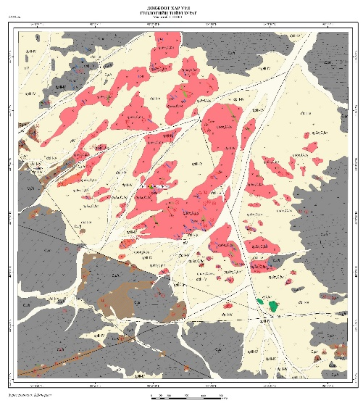
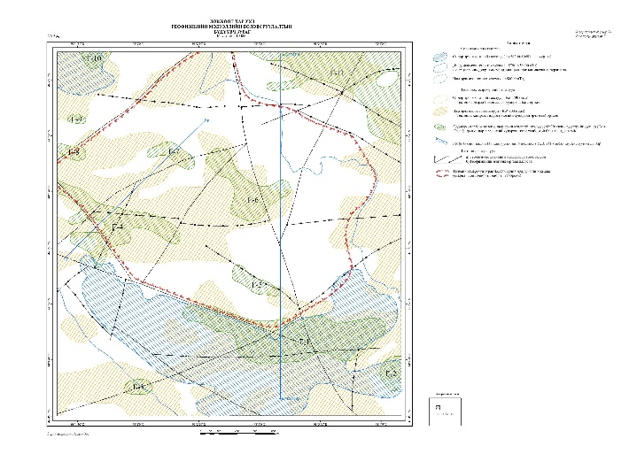
Studied-1. /2014-2018/. 1:50000 "Suman Khad-50" project
“ERDENES ALT RESOURCE” LLC
The presence of copper-molybdenum-gold (Cu, Mo, Au) was determined by geomin LLC 1:50000 scale geological mapping and general prospecting in an area of 15.2 km2 by geophysical induced polarization average gradient method, 30.5 km electrical survey and 156 km magnetic survey. , performed a 22.1 t.km search route, excavated 28 m3 of swag, took out 52 point samples, 8 groove samples, 11 channel geochemical samples, 17 samples, 15 samples, and 22 petrophysical samples.
In the central part of the manifestation, 88 m of primary geochemical samples were taken by 4 lines, and in the southwestern part of the manifestation, secondary geochemical sampling was carried out with a grid of 100x25 meters in the area of intensively developed hydrothermal transformation. As a result, promising gold-molybdenum mineralization points were found.

Slide 10
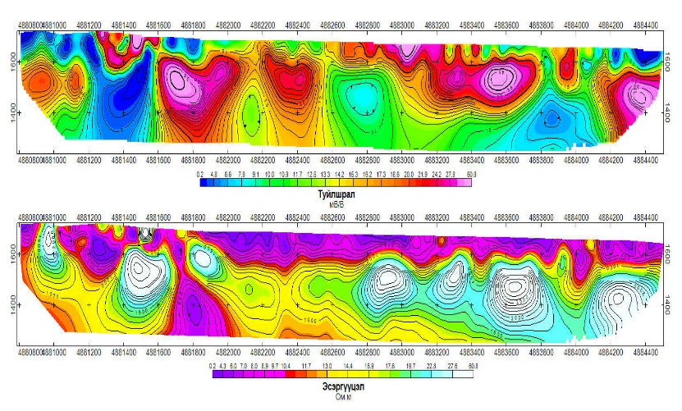
Studied-2. /year 2019/. "AMC-2017" project
“ERDENES ALT RESOURCE” LLC
Within the framework of the Geological Research Center (state-owned industrial estate) "AMS-2017" project, performed a 12.9t.km prospecting route in Dovjoot field (Cu,Mo,Au), 1 spot sample, and a total of 10.5t.km of electricity along 3 lines with a length of 3.5km in the central part of the field. exploration (AT-PD) work has been completed respectively.

